Slide 1
Jockey Puja Creative Change Photographs

Slide 2
Siliguri

Slide 3
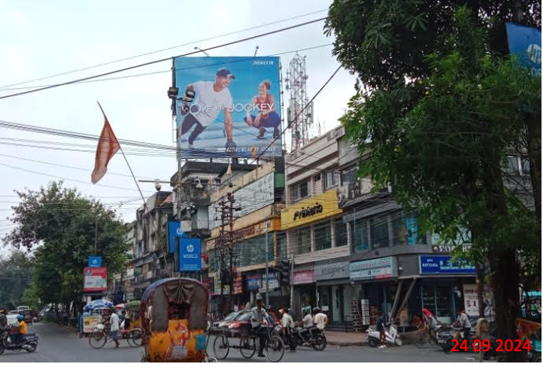
Siliguri – Church Road- 40 x 40 - FL

Slide 4
Siliguri – Church Road- 40 x 40 - FL

Slide 5
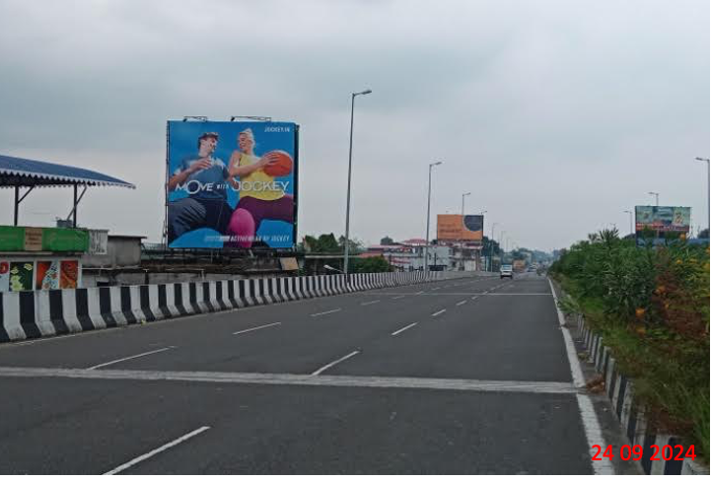
Siliguri – Bihar more flyover facing airport - 30 x 30 - FL

Slide 6
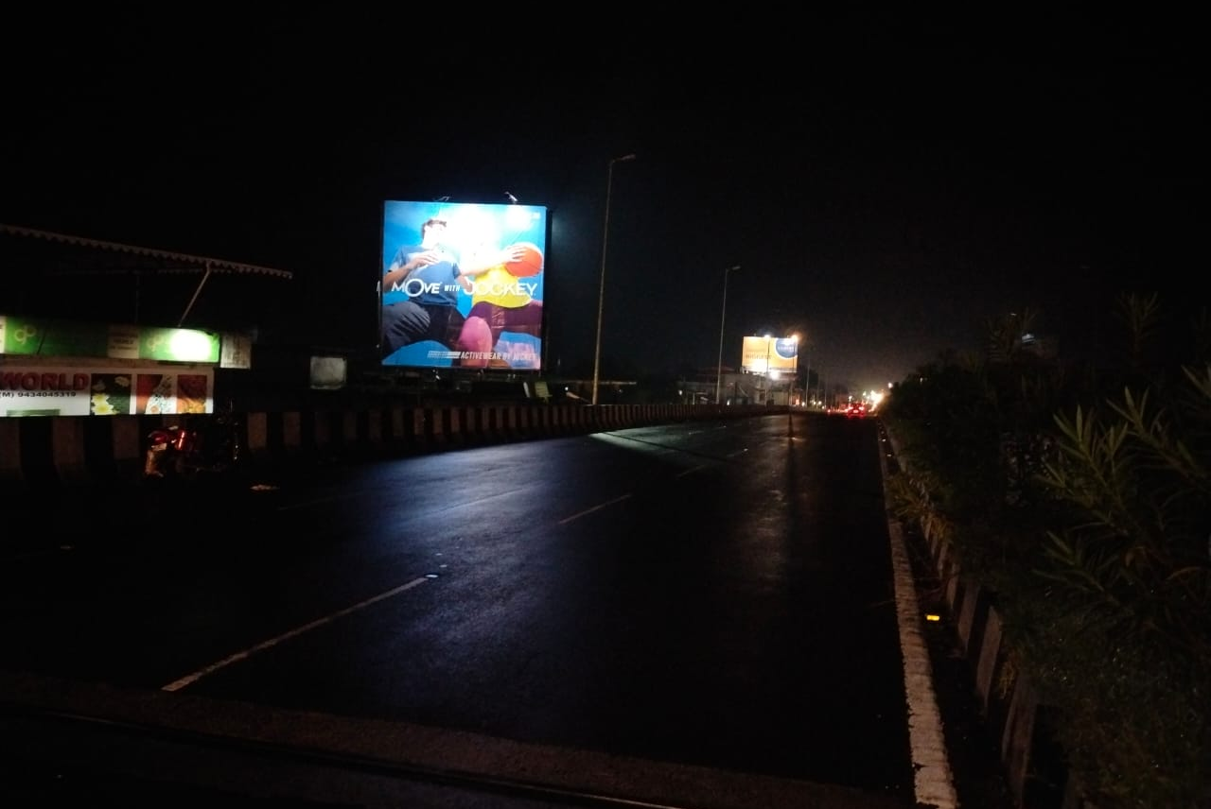
Siliguri – Bihar more flyover facing airport - 30 x 30 - FL

Slide 7
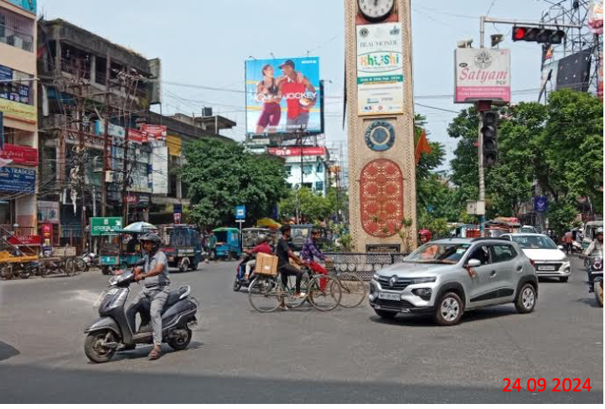
Siliguri – Pani Tanki More- 40 x 40 - FL

Slide 8
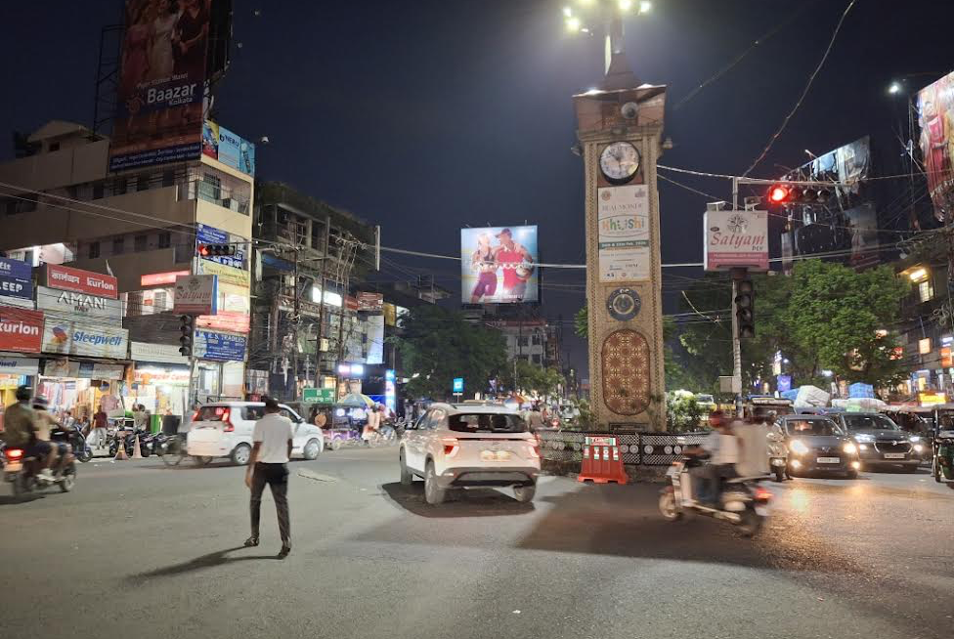
Siliguri – Pani Tanki More- 40 x 40 - FL

Slide 9
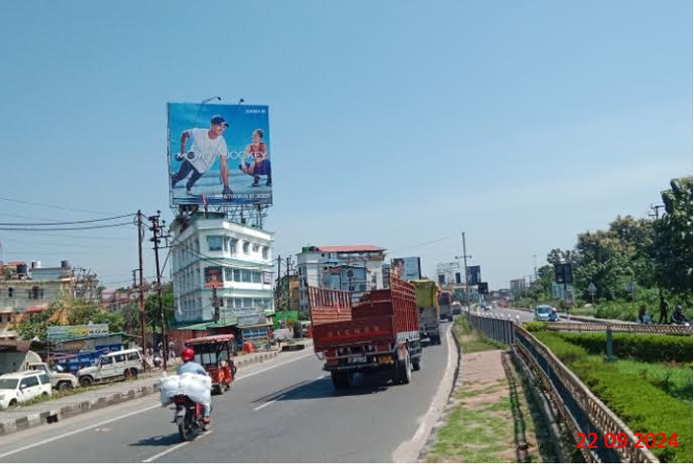
Siliguri – Noukaghat More - 40 x 40 - FL

Slide 10
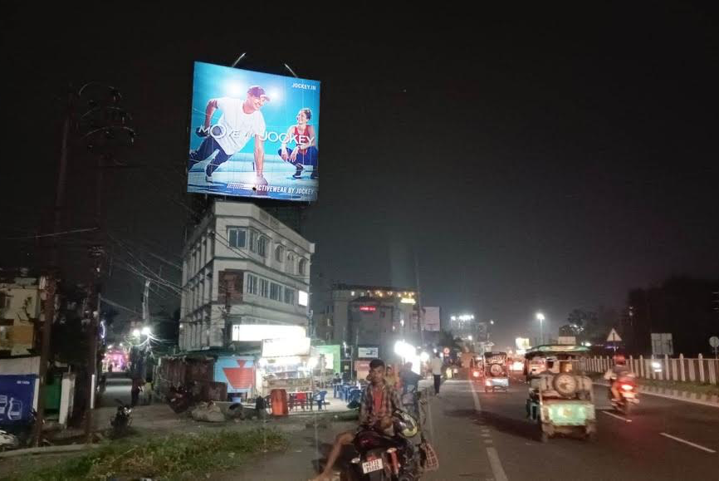
Siliguri – Noukaghat More - 40 x 40 - FL

Slide 11
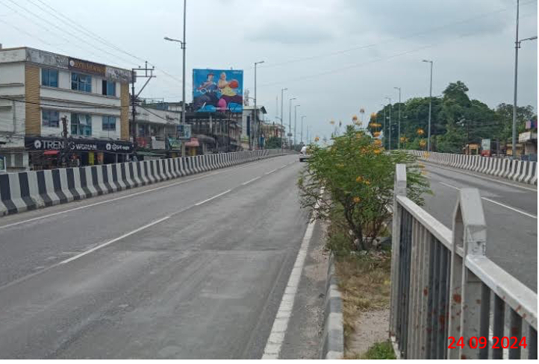
Siliguri – Shivmandir Flyover- 30 x 25 - FL

Slide 12
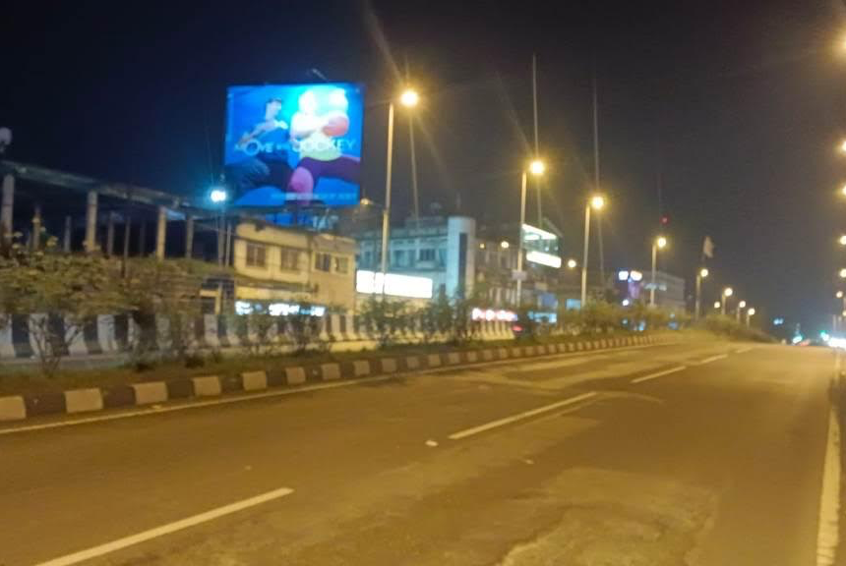
Siliguri – Shivmandir Flyover- 30 x 25 - FL

Slide 13
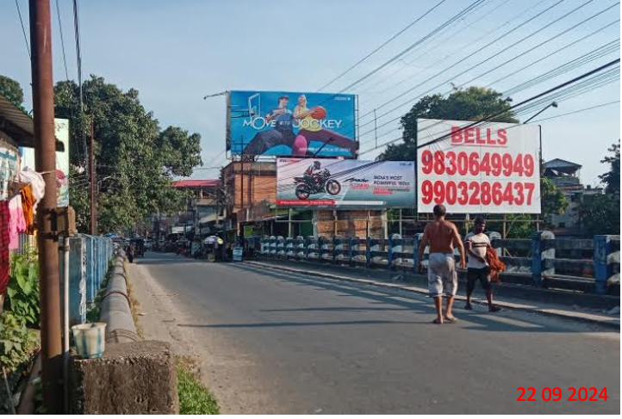
Siliguri – NJP Station Road - 40 x 20 - NL
Look for better site
Alternate

Slide 14
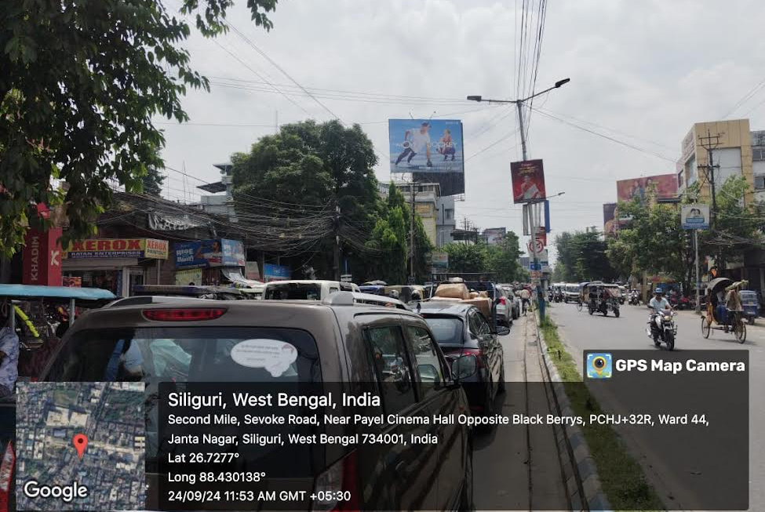
Siliguri – Sevoke Road,Payel Cinema- 40 x 30 - FL

Slide 15
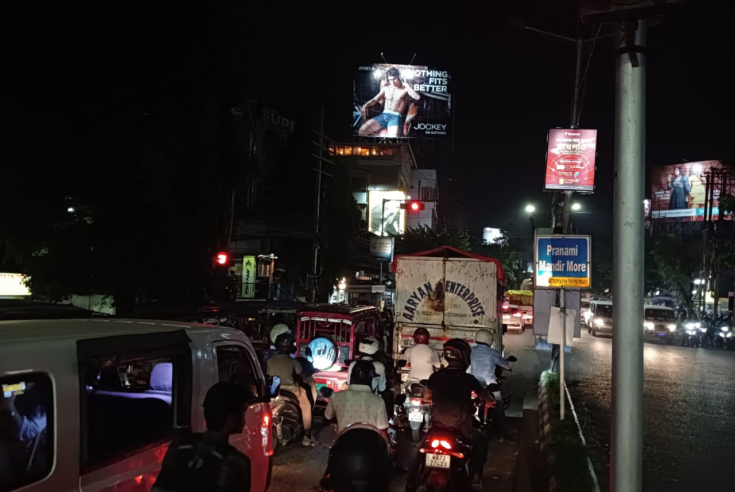
Siliguri – Sevoke Road,Payel Cinema- 40 x 30 - FL

Slide 16
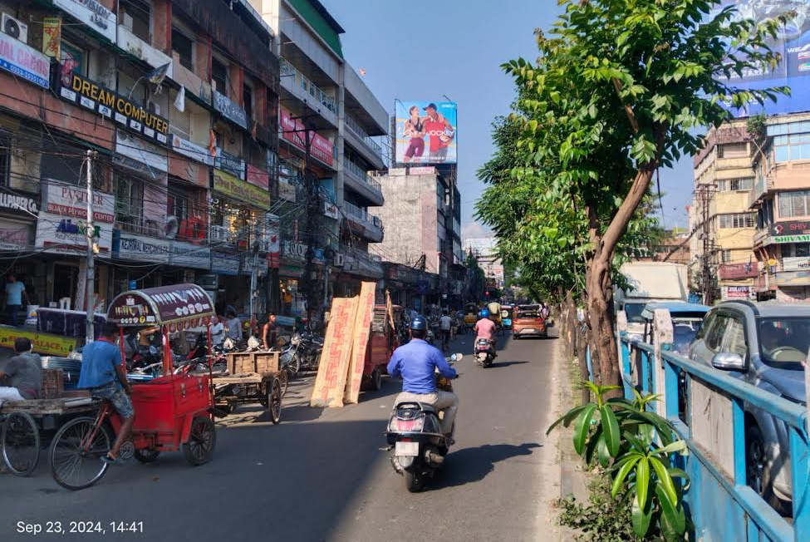
Siliguri - Sevoke Road, Church Road Xing..FCG. Sevoke More - 30 x 30 - FL

Slide 17
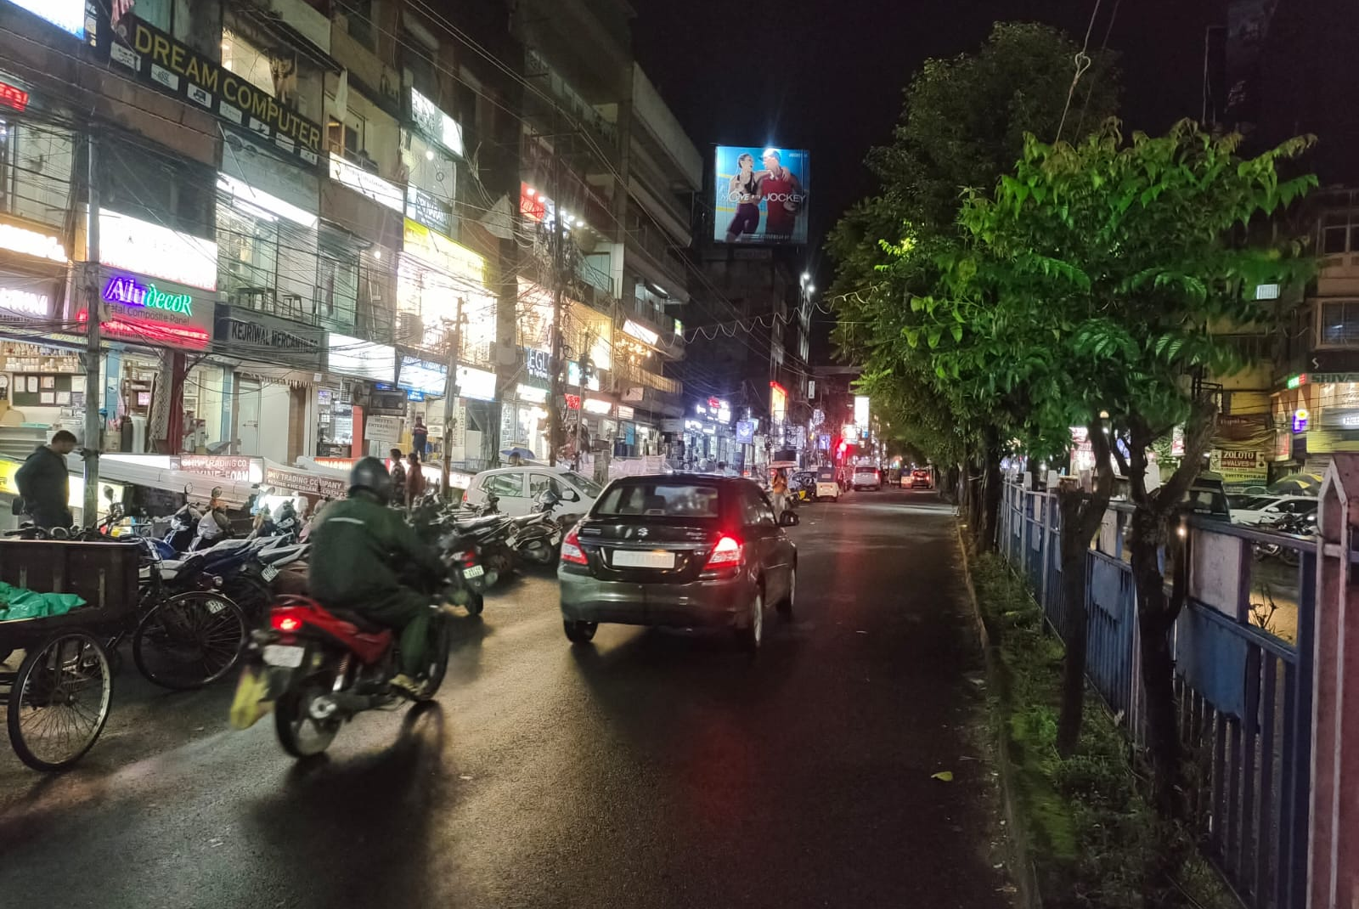
Siliguri - Sevoke Road, Church Road Xing..FCG. Sevoke More - 30 x 30 - FL

Slide 18
Hooghly

Slide 19
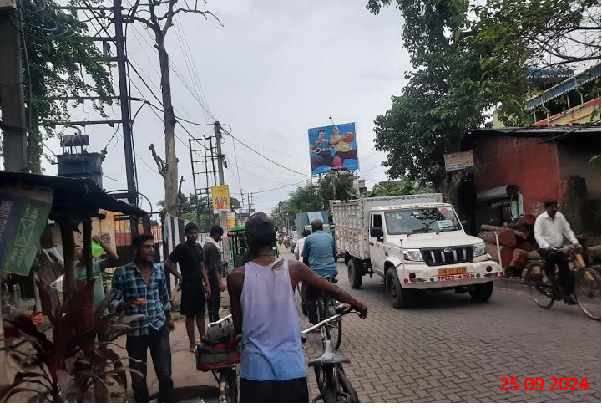
Hooghly - Near Nagar More – 25 x 25 - FL

Slide 20
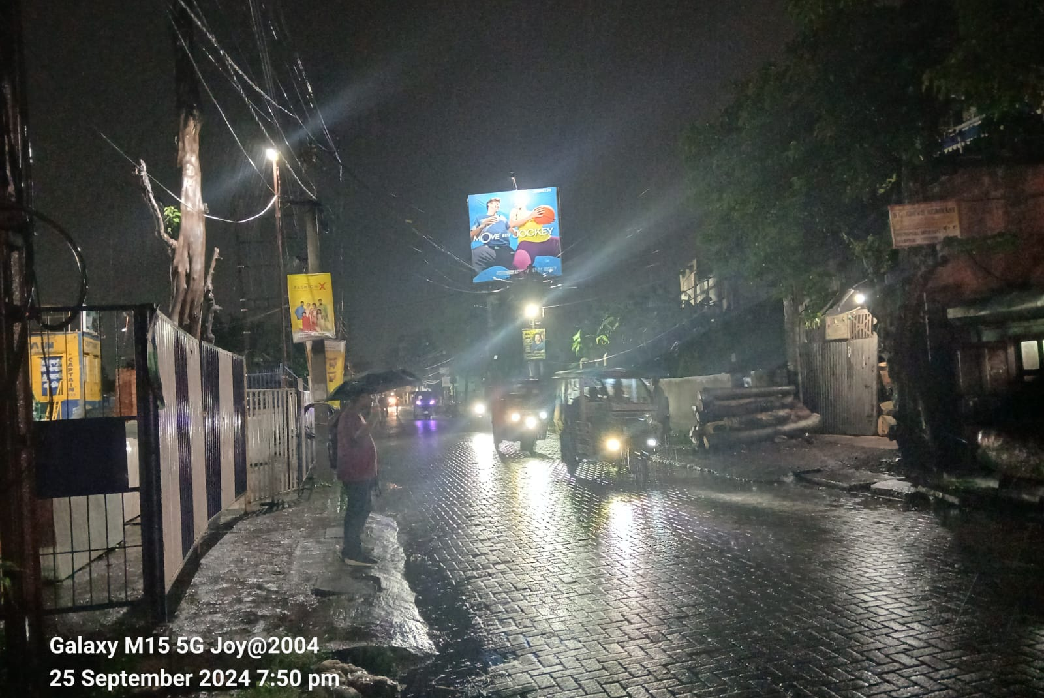
Hooghly - Near Nagar More – 25 x 25 - FL

Slide 21
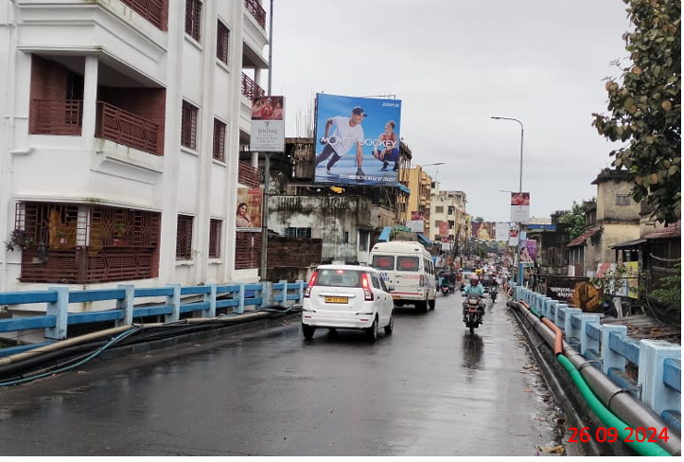
Hooghly - Fly Over– 20 x 20 - NL

Slide 22
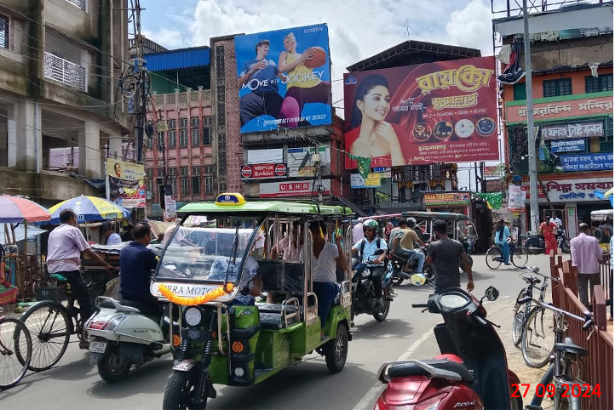
Hooghly - Chandannagar Laxmi Bazar– 20 x 20 - NL

Slide 23
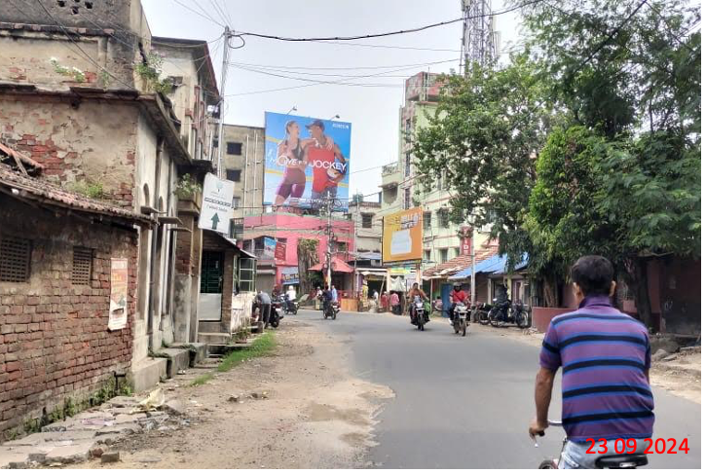
Hooghly - Konnagar Bata More – 25 x 25 - NL

Slide 24
Bardhaman

Slide 25
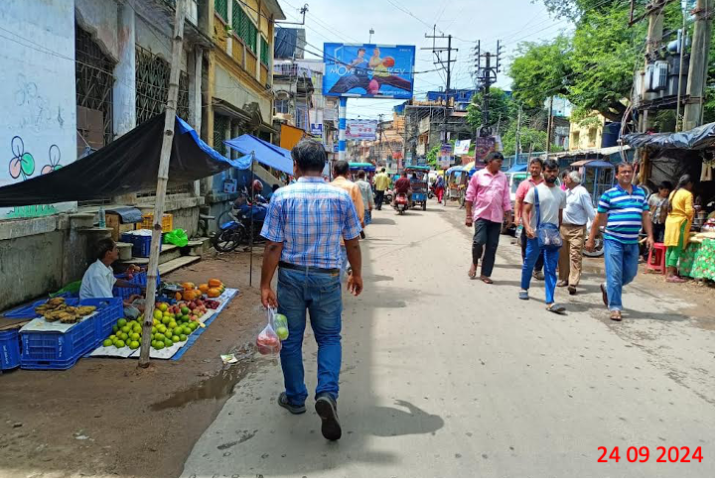
Bardhaman -Khosbanag– 18 x 10 (2units) - FL

Slide 26
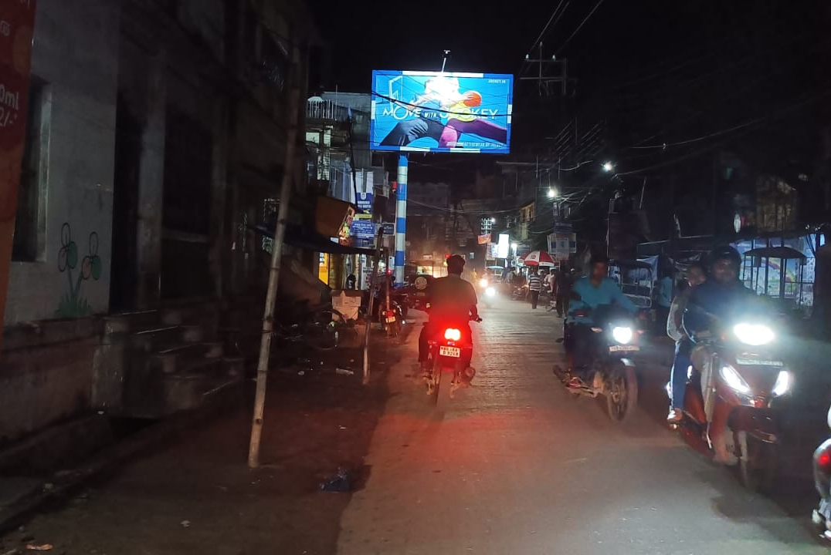
Bardhaman -Khosbanag– 18 x 10 (2units) - FL

Slide 27
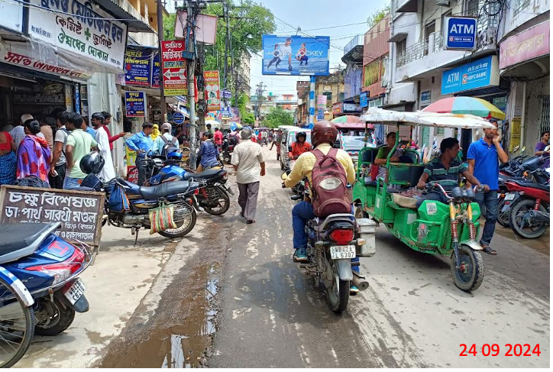
Bardhaman -Khosbanag– 18 x 10 (2units) - FL

Slide 28
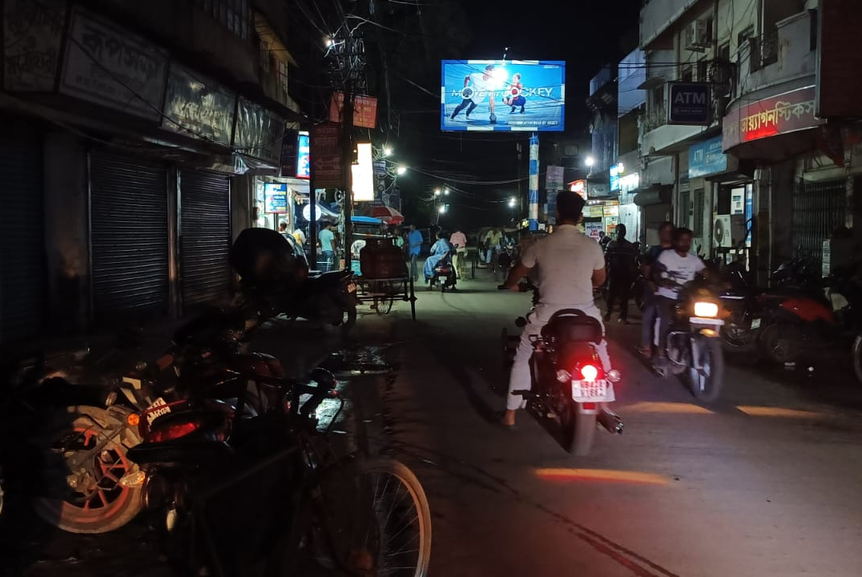
Bardhaman -Khosbanag– 18 x 10 (2units) - FL

Slide 29
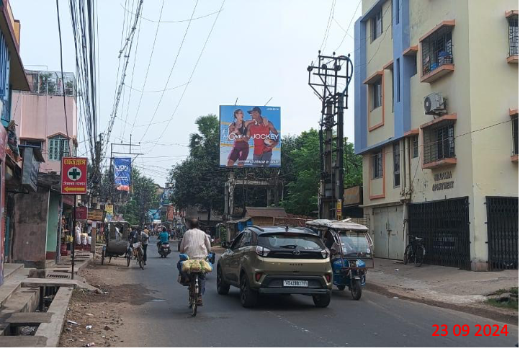
Bardhaman -Vivekananda College– 20 x 20 - NL

Slide 30
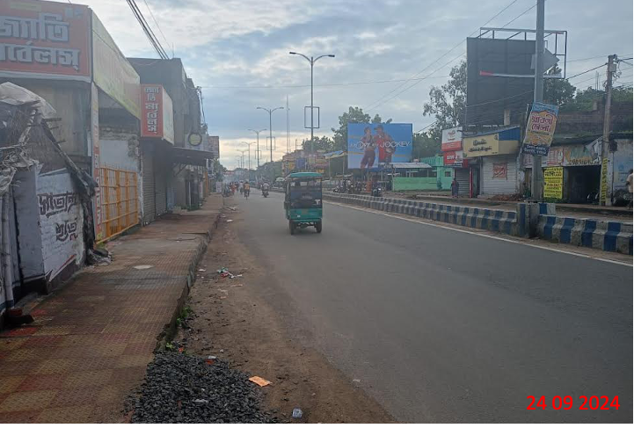
Bardhaman - BC Road – 30 x 20 - NL

Slide 31
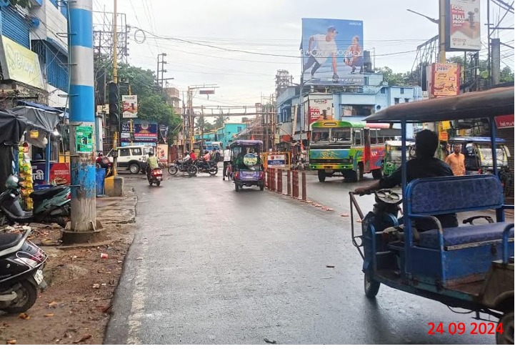
Bardhaman - Parbirhata– 20 x 20 - NL

Slide 32
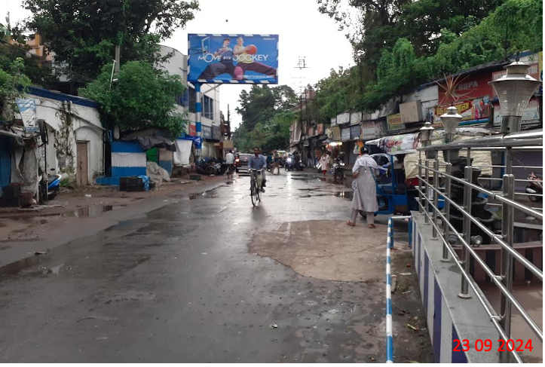
Bardhaman - Bwn B.C Road Carzonegate Market - 20 x 10(2 units) - FL

Slide 33
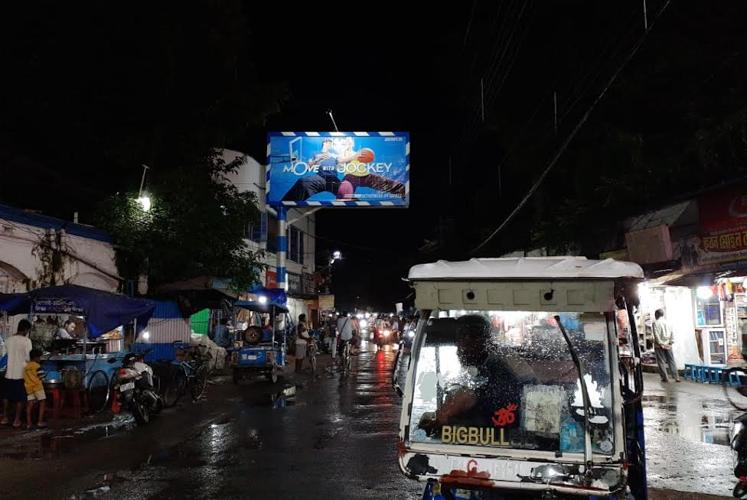
Bardhaman - Bwn B.C Road Carzonegate Market - 20 x 10(2 units) - FL

Slide 34
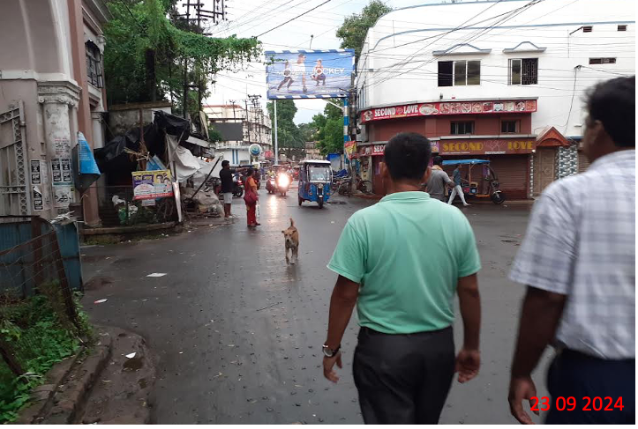
Bardhaman - Bwn B.C Road Carzonegate Market - 20 x 10(2 units) - FL

Slide 35
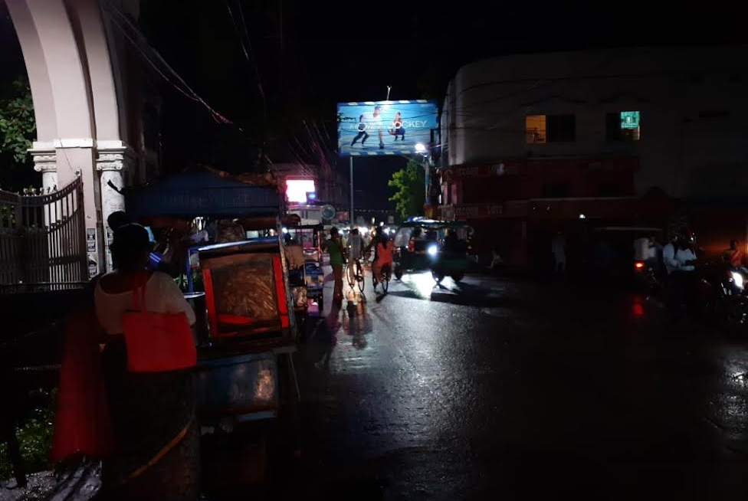
Bardhaman - Bwn B.C Road Carzonegate Market - 20 x 10(2 units) - FL

Slide 36
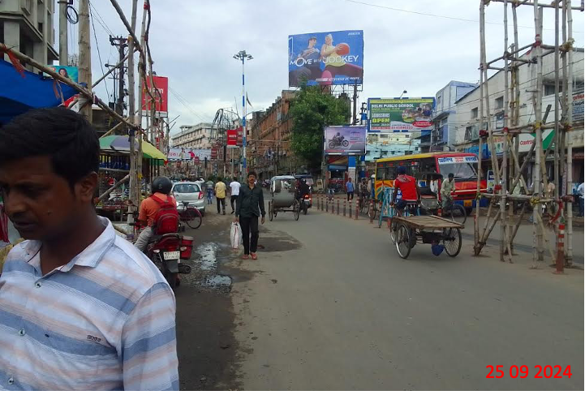
Bardhaman - Tinkonia Market- 30 x 20 - FL

Slide 37
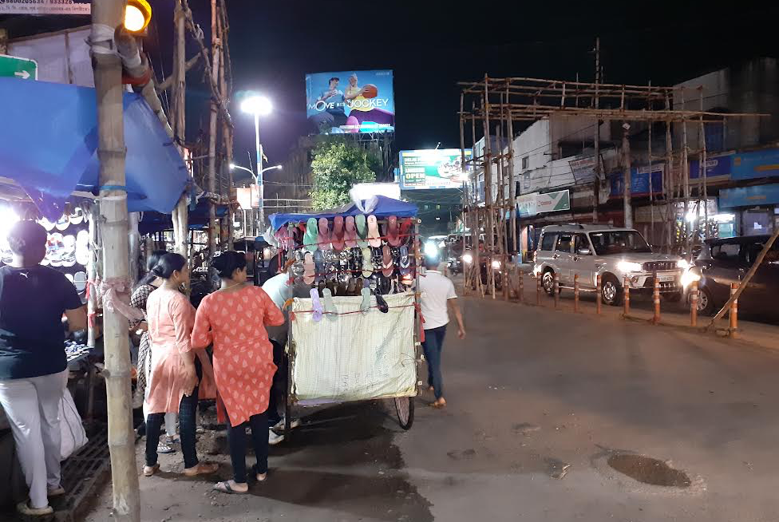
Bardhaman - Tinkonia Market- 30 x 20 - FL

Slide 38
Durgapur

Slide 39
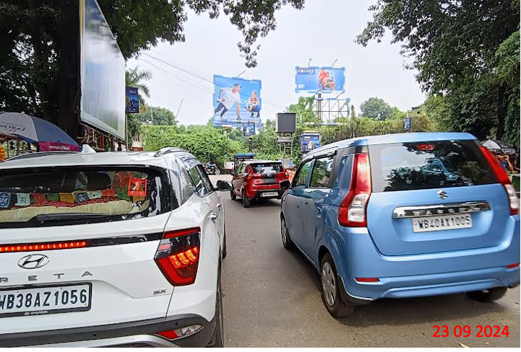
Durgapur - City Centre– 20 x 20 – NL

Slide 40
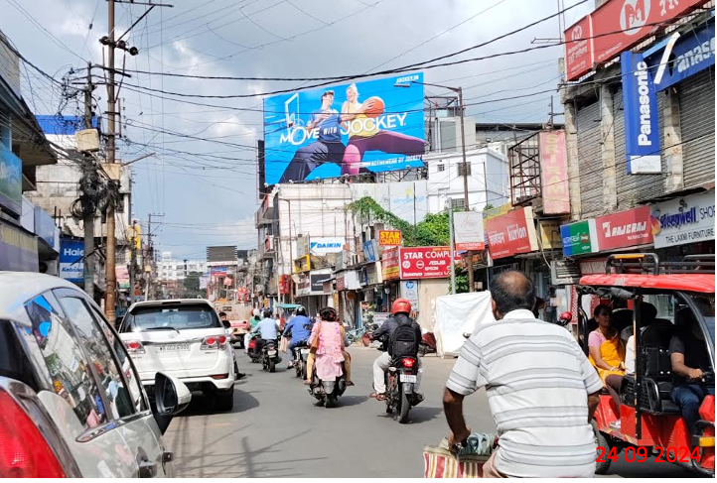
Durgapur - Benachity Market – 50 x 25 - FL

Slide 41
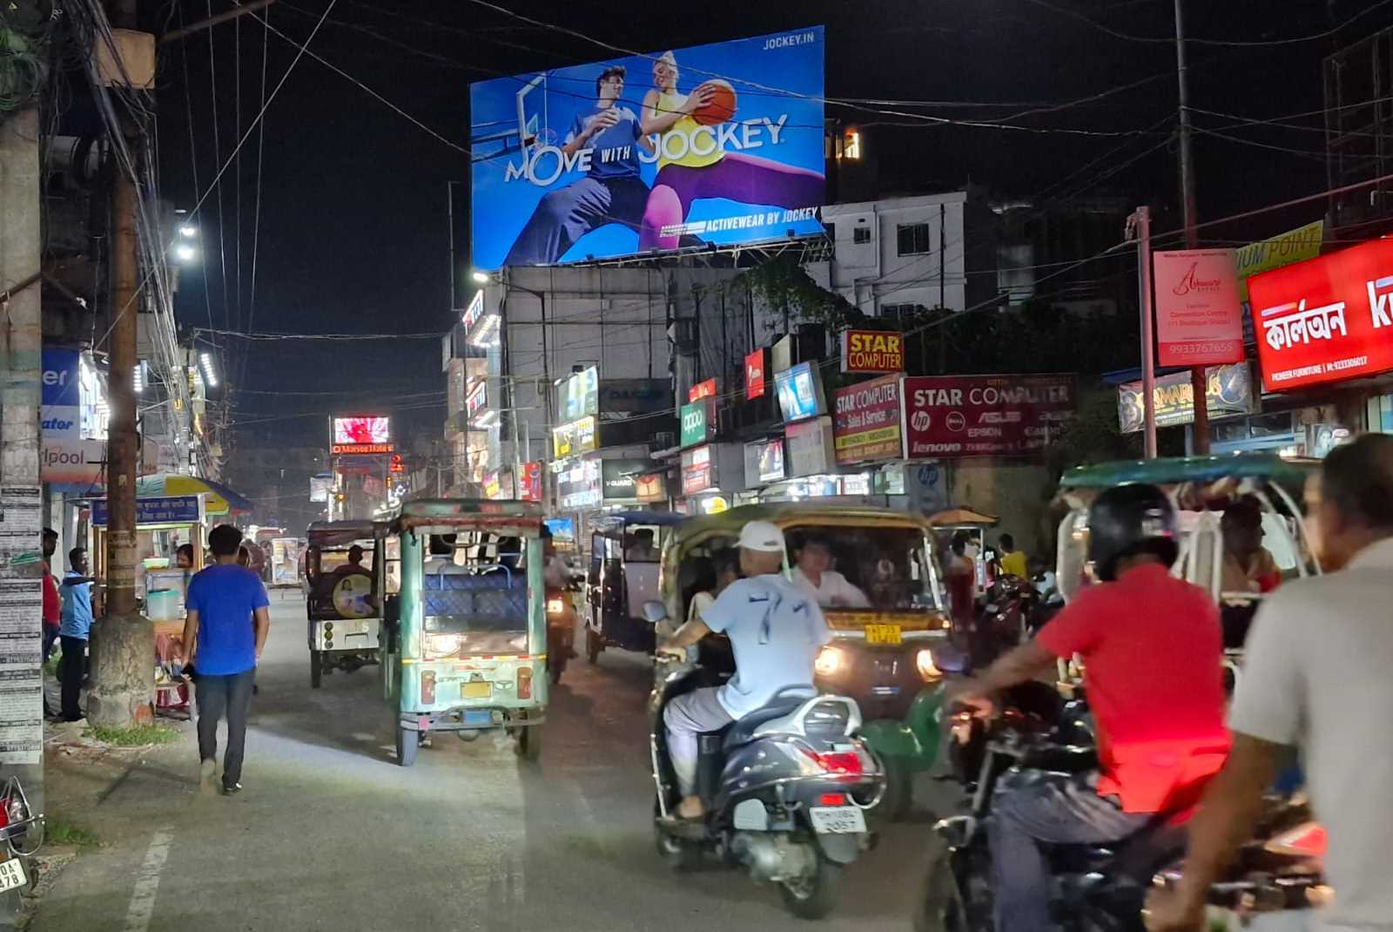
Durgapur - Benachity Market – 50 x 25 - FL

Slide 42
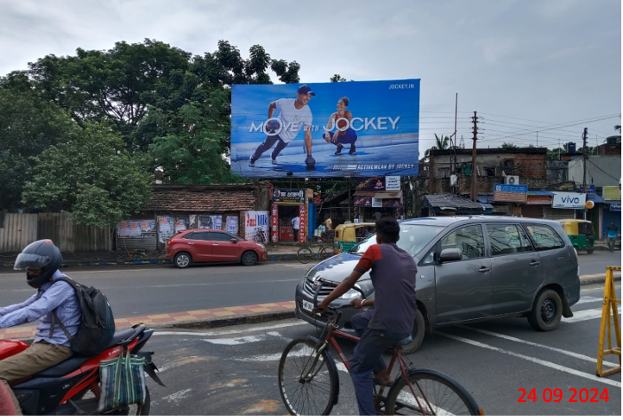
Durgapur - Muchipara Crossing– 40 x 20 - FL

Slide 43
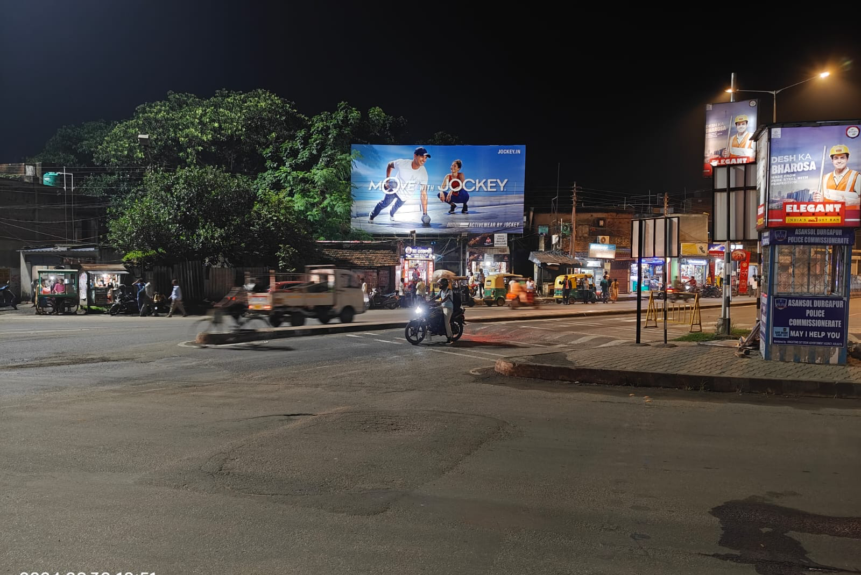
Durgapur - Muchipara Crossing– 40 x 20 - FL

Slide 44
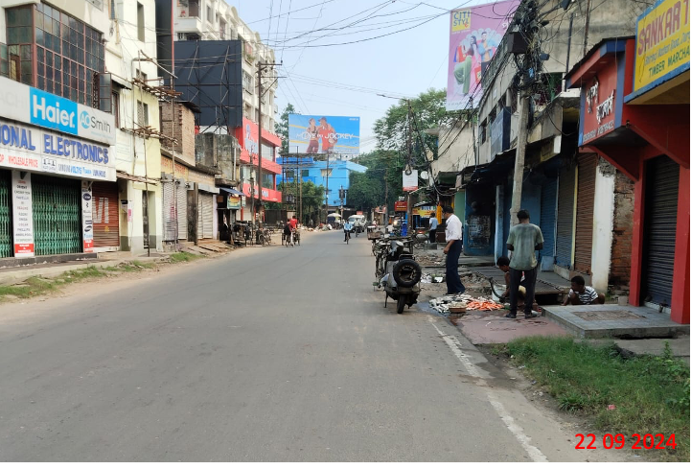
Durgapur - Bhiringee Market 40 x 20 - FL

Slide 45
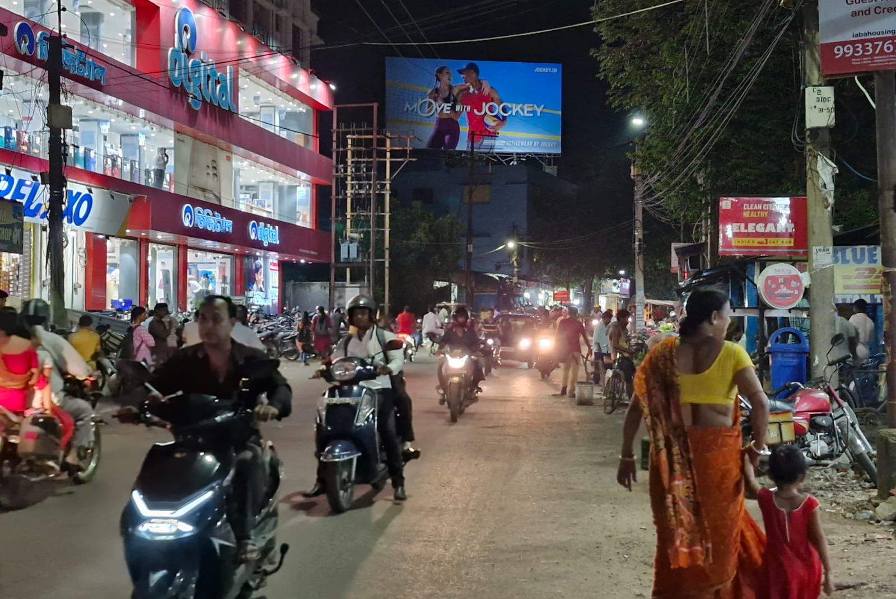
Durgapur - Bhiringee Market 40 x 20 - FL

Slide 46
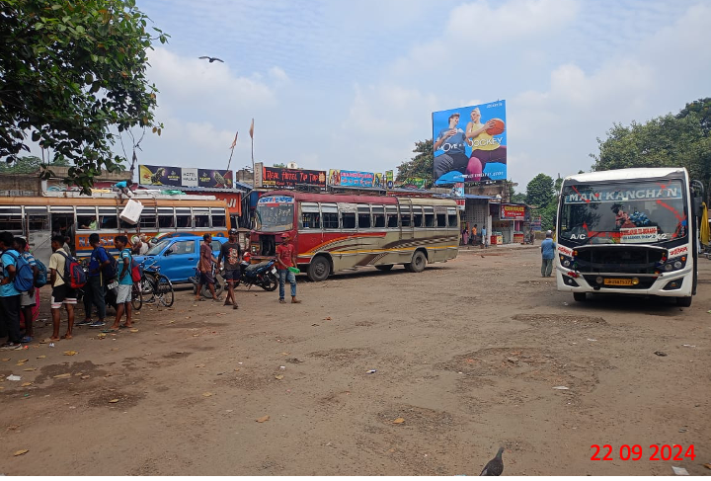
Durgapur - Station Bazar SBSTC Bus Stand – 30 x 30 - NL

Slide 47
Thank You

